Slide 1
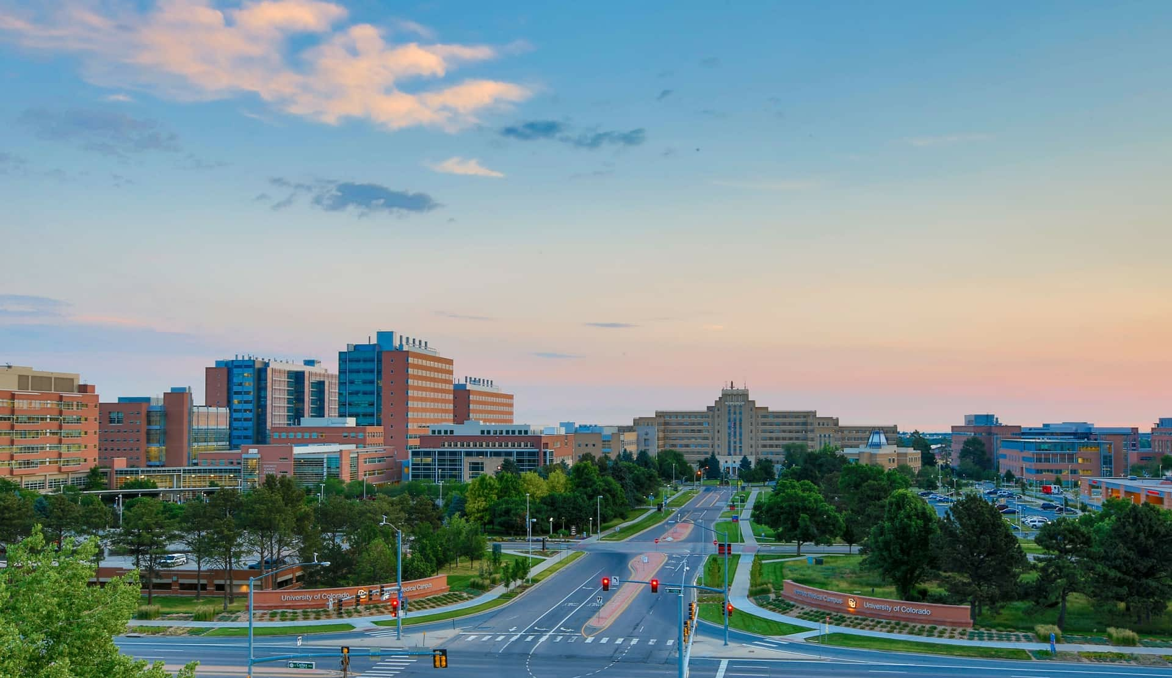
Artificial Intelligence for Ophthalmic Research
Jayashree Kalpathy-Cramer, PhD​
May 3rd, 2025

Slide 2
Outline
Exercise 1: Using ChatGPT to extract data from a screenshot
Exercise 2: Simple data analysis like regression, plotting
Exercise 3: Using NotebookLM

Slide 3
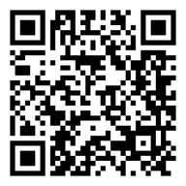
Set up
GitHub repo with files/notebooks:
https://github.com/QTIM-Lab/ARVO25_AI4Oph
GitHub

Slide 4
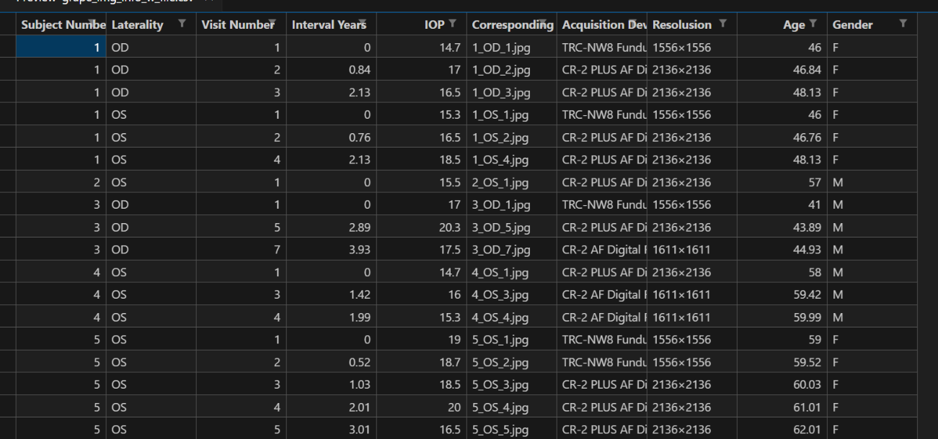
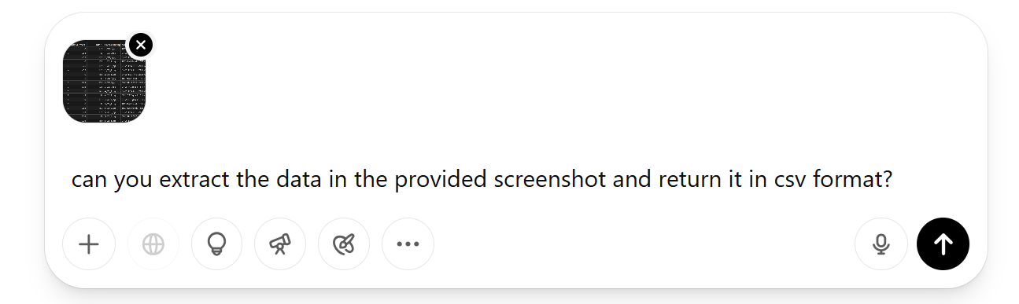
Exercise 1: Using ChatGPT to extract data from a screenshot
Dataset: GRAPE
Open chatgpt.com
Prompt: “can you extract the data in the provided screenshot and return it in csv format?”

Slide 5
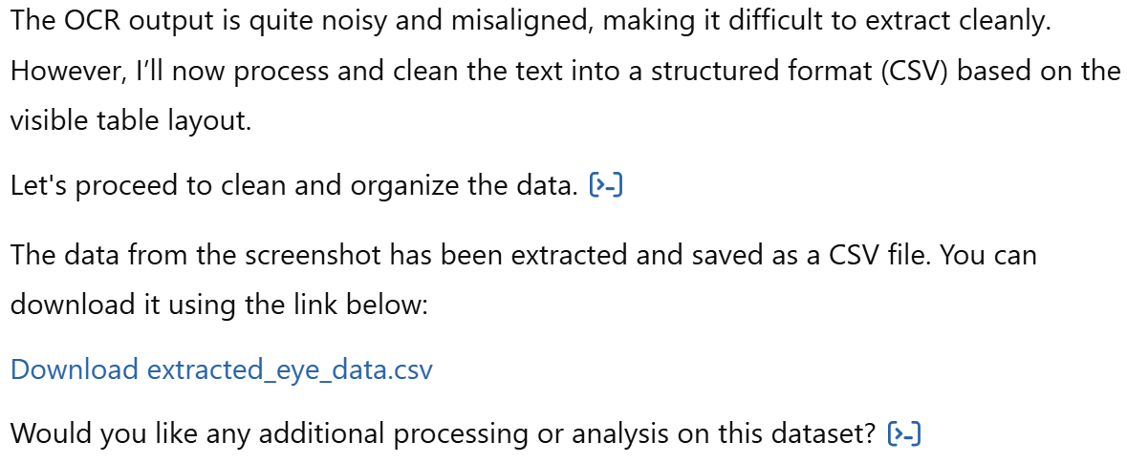
Exercise 1: Using ChatGPT to extract data from a screenshot

Slide 6
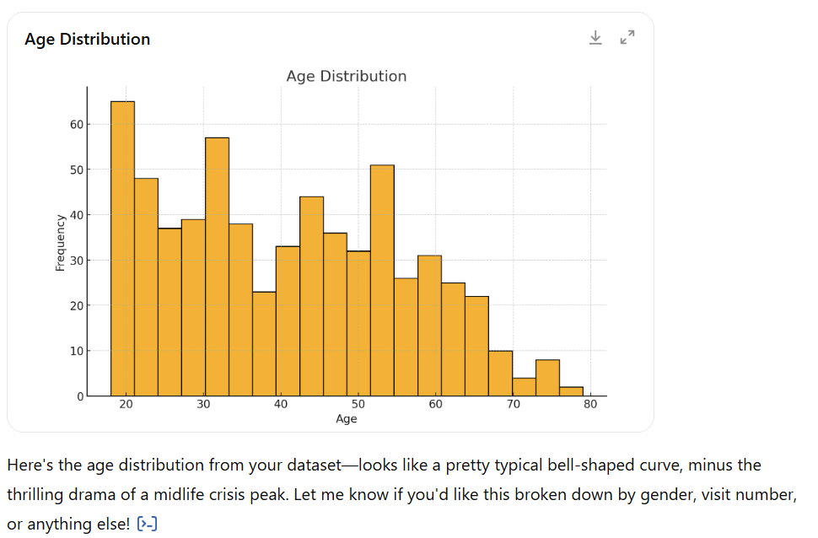
Exercise 2: Data analysis - plotting
Dataset: GRAPE
Open chatgpt.com
Prompt: “given the provided csv file, can you plot the age distribution?”

Slide 7
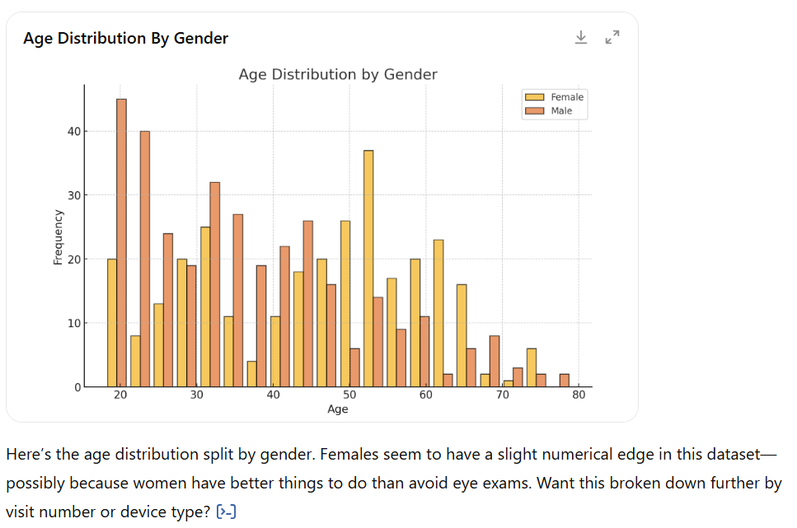
Exercise 2: Data analysis - plotting
Further separate by gender

Slide 8
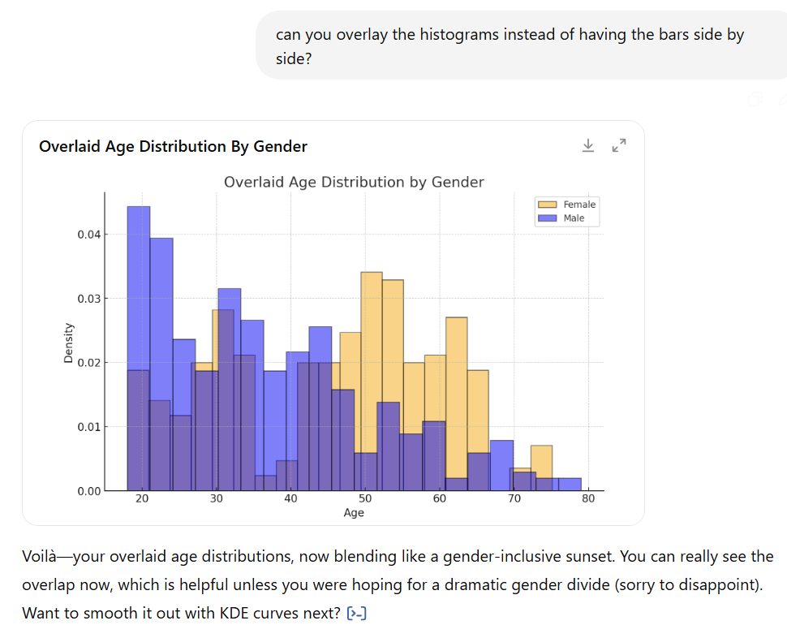
Exercise 2: Data analysis - plotting
Modify plot appearance

Slide 9
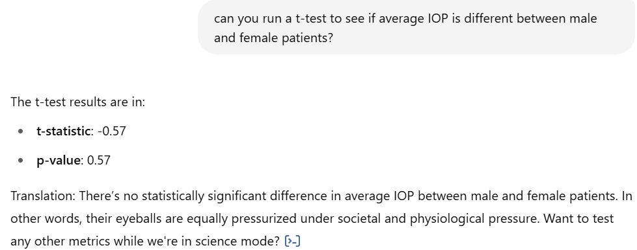
Exercise 2: Data analysis – statistical tests
Run t-test on IOP between male and female patients

Slide 10
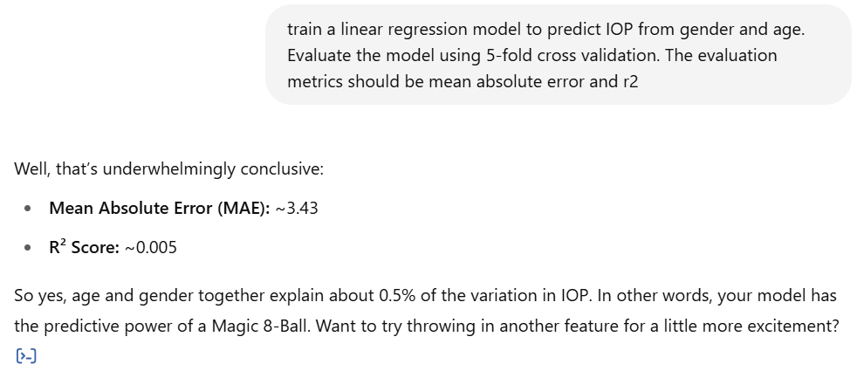
Exercise 2: Data analysis – regression
Train a linear regression model to predict IOP from demographic variables:
Gender
Age
Run 5-fold cross validation
Evaluate using
Mean Absolute Error
R2 score

Slide 11
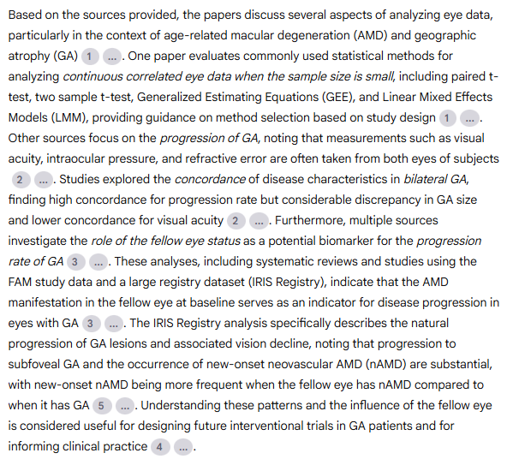
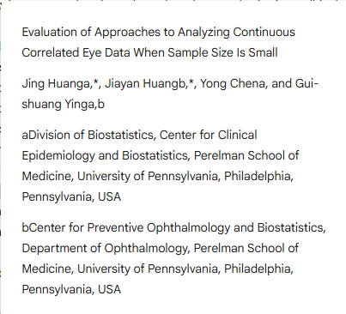
Exercise 3: Using NotebookLM
Data: list of 5 papers related to the role of the fellow eye in Geographic Atrophy patients
Overall task: help the researcher understand what is currently known on the topic and formulate new research questions
“can you provide a paragraph summarizing the uploaded papers?”

Slide 12
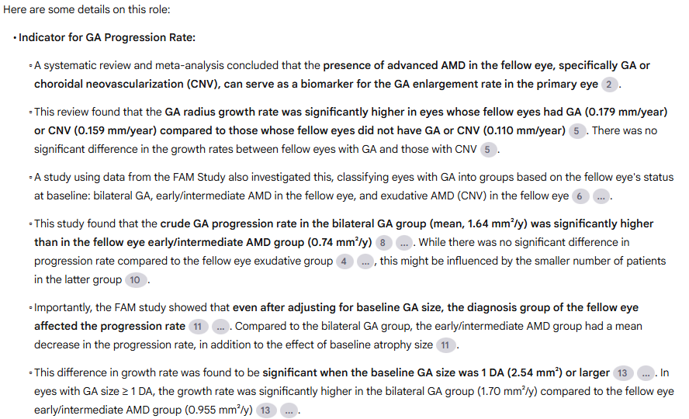
Exercise 3: Using NotebookLM
“can you go into more details on the role of the fellow eye status as a potential biomarker for the progression rate of GA?“

Slide 13
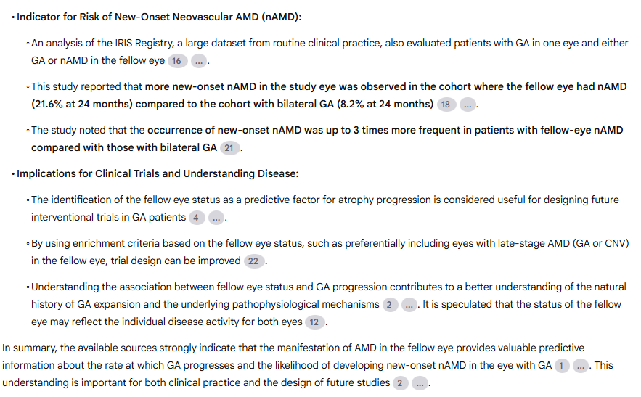
Exercise 3: Using NotebookLM
“can you go into more details on the role of the fellow eye status as a potential biomarker for the progression rate of GA?“

Slide 14
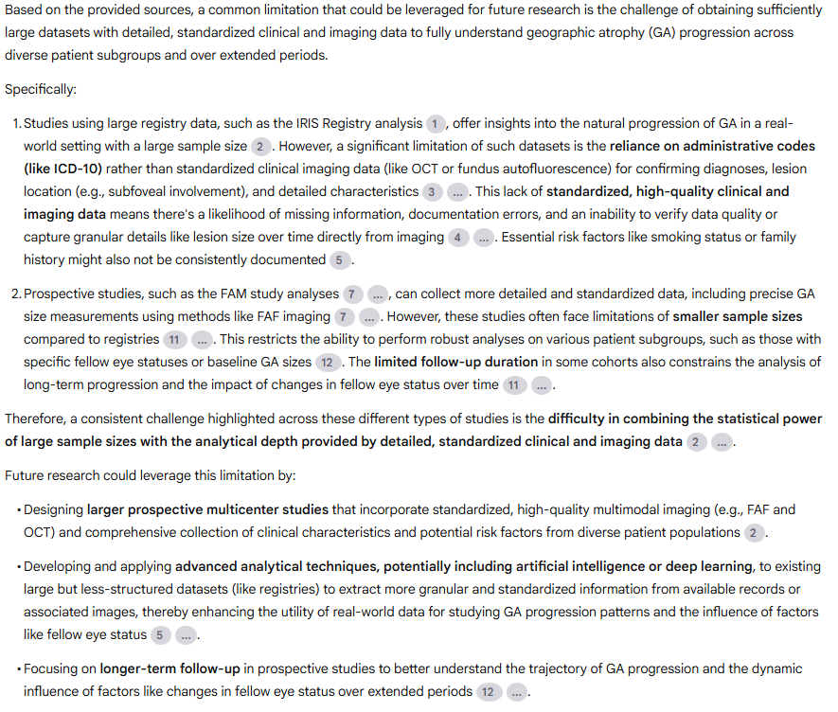
Exercise 3
“can you identify one common limitation of these studies that could be leveraged for future research?”

Slide 15
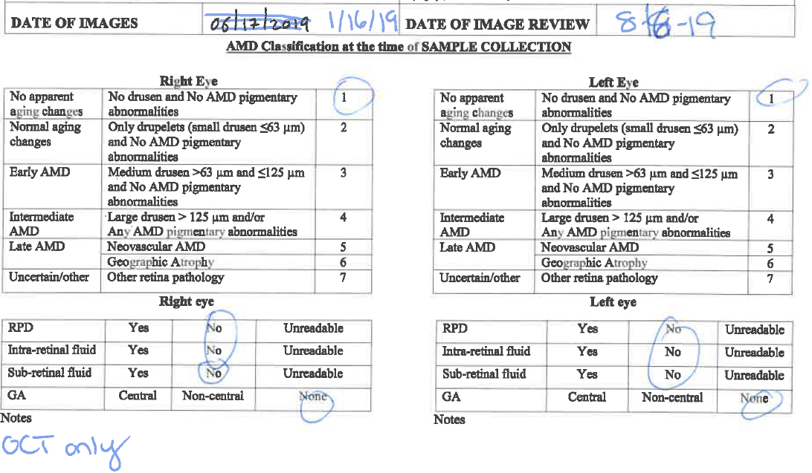
Exercise 3: Using NotebookLM
Extract information from a manually filled-out form
Go to https://notebooklm.google.com/
Upload file “filled_out_form.pdf” from files/ folder

Slide 16
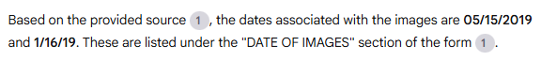
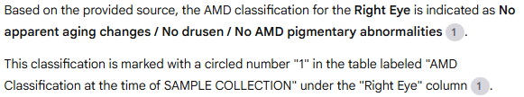
Exercise 3: Using NotebookLM
“What is the image date?”
“what is the AMD classification for the right eye?”

Slide 17
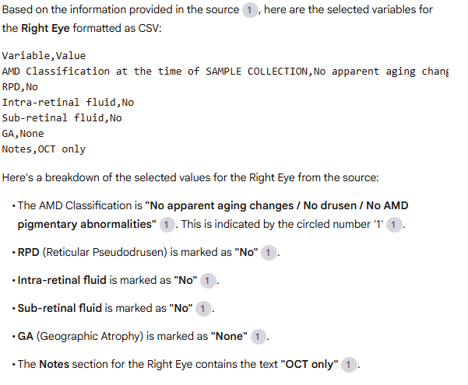
Exercise 3: Using NotebookLM
“can you extract all the selected variables for the right eye and display them in csv format?“

Slide 18
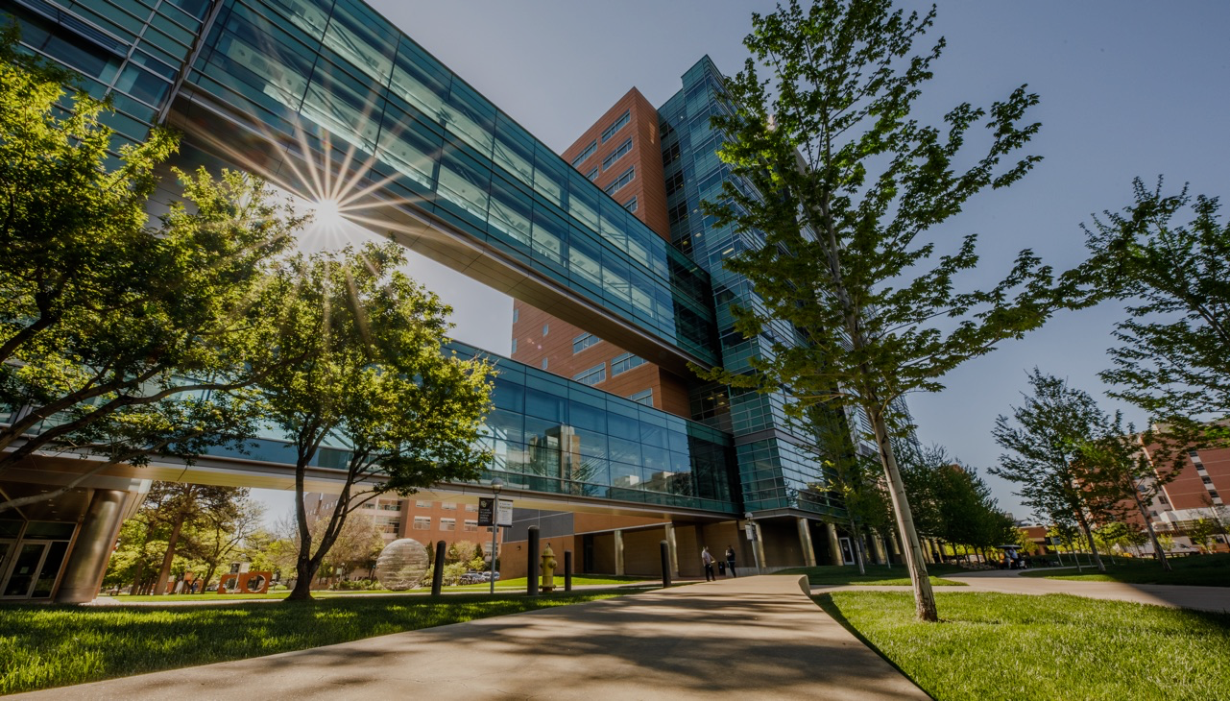
THANK YOU

